Slide 1


Boundaries in Ministry
Rev. Tom Mann – MA, BCMHC

Slide 2
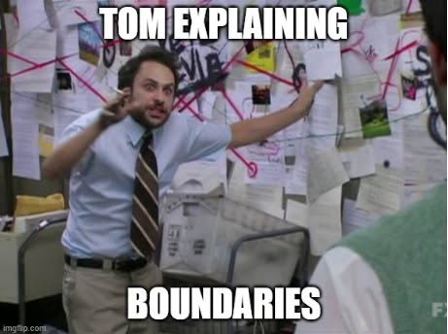

Slide 3
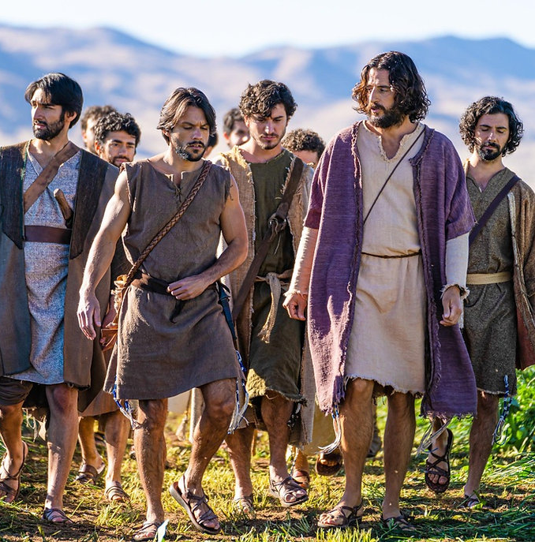
Mark 6:31
³⁰ The apostles gathered around Jesus and reported to Him all they had done and taught. ³¹ Then, because so many people were coming and going that they did not even have a chance to eat, He said to them, “Come with Me by yourselves to a quiet place and get some rest.”

Slide 4
Ministry
Sacrifice
Self-Care
³⁰ The apostles gathered around Jesus and reported to Him all they had done and taught. ³¹ Then, because so many people were coming and going that they did not even have a chance to eat, He said to them, “Come with Me by yourselves to a quiet place and get some rest.”

Slide 5

Why Boundaries
God’s Call to you is too important to allow circumstances and people to distract, detour, and derail your ministry.
Setting appropriate boundaries protects all that God has called you to do.

Slide 6
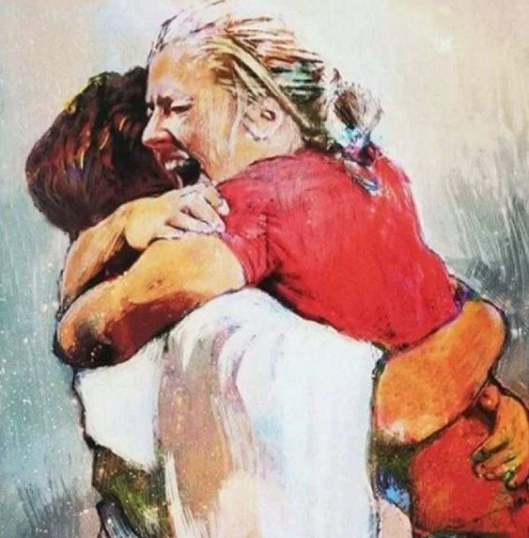
Greatest Commandment
^{“30} Love the Lord your God with all your heart and with all your soul and with all your mind and with all your strength.’^{[b]} ³¹ The second is this: ‘Love your neighbor as yourself.’^{[c]} There is no commandment greater than these.”
Mark 12:30-31

Slide 7
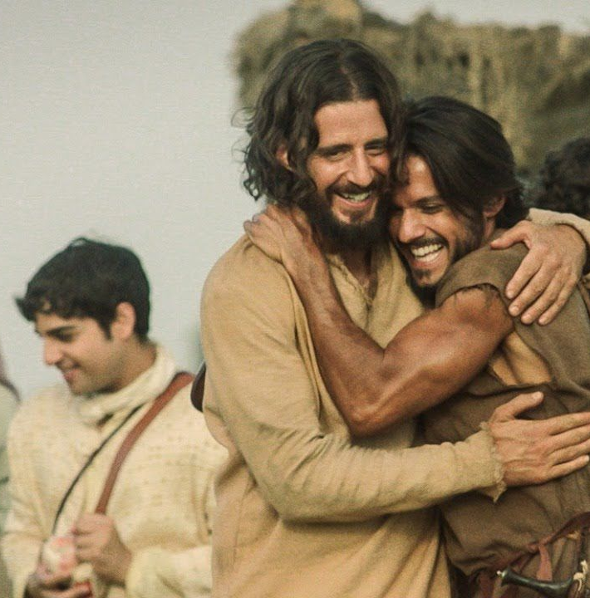
Jesus Loved
People
The Poor
The Sick/Lame
Pharisees/Sadducees/Scribes
Sinners
The Disciples
Children
His People
The World

Slide 8
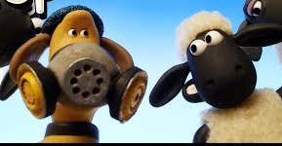
Sometimes the Sheep Stink
As the shepherd of your flock you will deal with all kinds of people just like Jesus did. And not all the people you shepherd are going to be – um – pleasant. Some people are “EGRs” - Extra Grace Required!

Slide 9
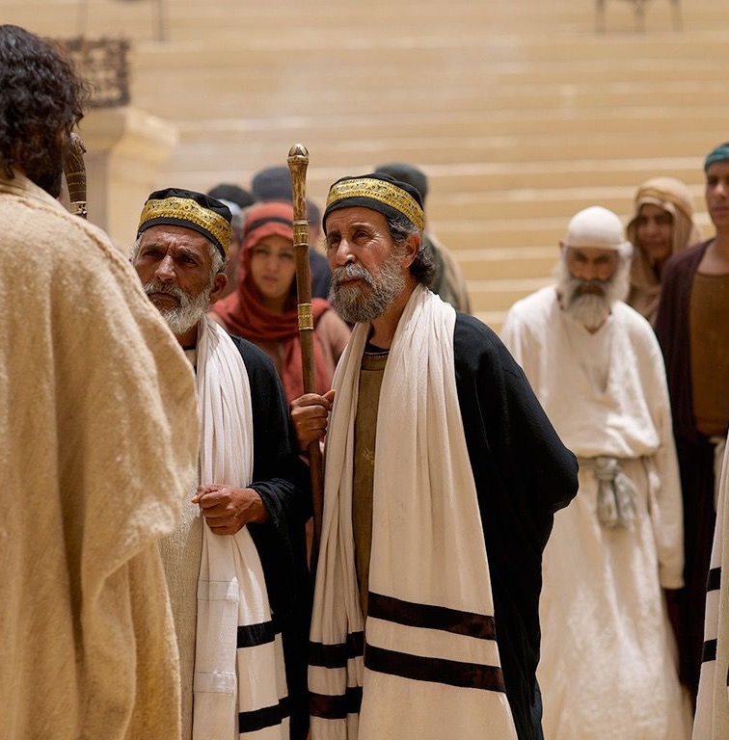
Jesus’s Adversaries
Pharisees
Sadducees
Scribes
Sanhedrin
Family
Judas
The Mob
Romans
Religious Leaders
Lawyers
The Government
Trusted People
Congregants
The Culture
The World Order

Slide 10
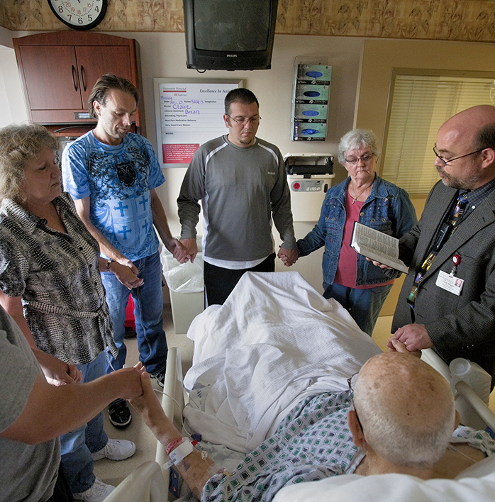
All Service
Is Sacrifice
Ministry has a cost:
Time
Emotions
Finances
Reputation
Physical/Mental Strain
Family Friction
Spiritual Warfare

Slide 11
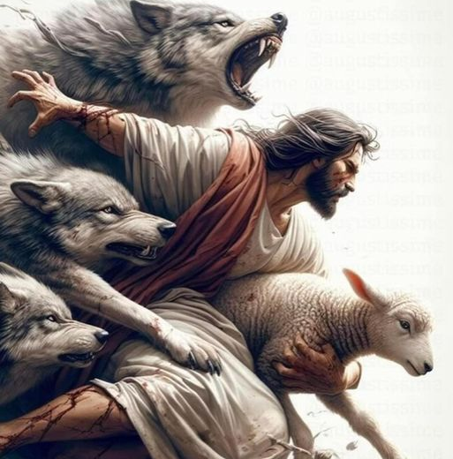
Jesus Had Boundaries
To understand where our boundaries should be in ministry we need to look to our Rabbi and follow in His footsteps.

Slide 12
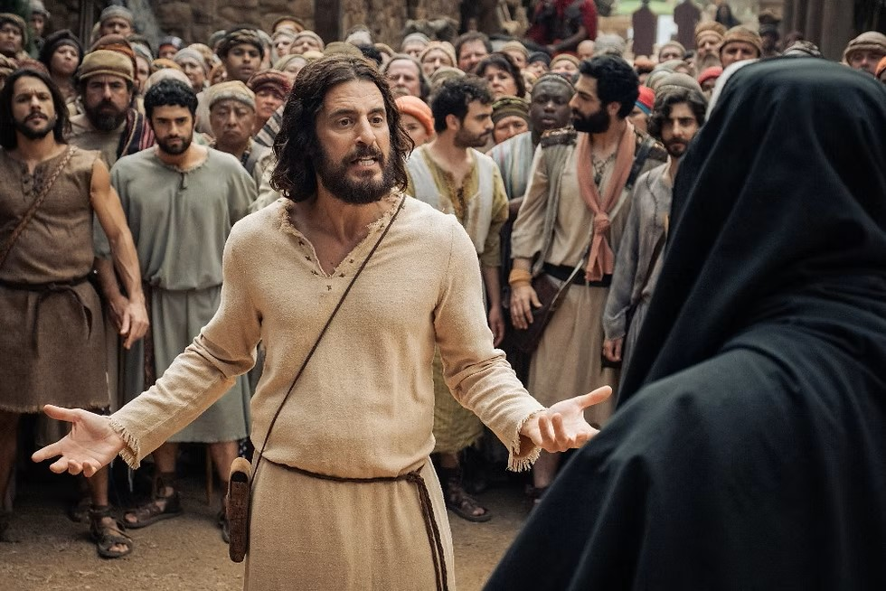
Jesus’s Boundaries
Never waivered from His call
MINISTRY​
Stood firm against detractors
PEOPLE​
Left the crowds to be alone with the Father
TIME​
Escaped the mob when it wasn’t His time
PHYSICAL ​
Didn’t take offense
EMOTIONS

Slide 13

Boundary Setting
Step One:
The Need is Not the Call

Slide 14
The Need is Not the Call
EACH OF US HAS A SPECIFIC CALL GOD HAS PUT ON OUR LIVES
“For we are His workmanship, created in Christ Jesus for good works, which God prepared beforehand that we should walk in them.” Ephesians 2:10
DON’T GIVE UP THE GREAT FOR THE GOOD
^{“18} But in fact God has placed the parts in the body, every one of them, just as he wanted them to be. ¹⁹ If they were all one part, where would the body be? ²⁰ As it is, there are many parts, but one body.” 1 Corinthians 12:18-20
NEVER WORK TOWARD YOUR WEAKNESSES
”²⁹ Are all apostles? Are all prophets? Are all teachers? Do all work miracles? ³⁰ Do all have gifts of healing? Do all speak in tongues^{[d]}? Do all interpret?”
1 Corinthians 12:29-30

Slide 15

Boundary Setting
Step Two:
Have a Sober Judgment

Slide 16
Have a Sober Judgment
BEFORE WE CAN DRAW BOUNDARIES, WE MUST EXAMINE OURSELVES
“Why do you see the speck that is in your brother's eye, but do not notice the log that is in your own eye? Or how can you say to your brother, ‘Let me take the speck out of your eye,’ when there is the log in your own eye? You hypocrite, first take the log out of your own eye, and then you will see clearly to take the speck out of your brother's eye.” Matthew 7:3-5
UNDERSTAND YOURSELF SO WELL YOU KNOW YOUR PERSONAL BOUNDARIES
“For by the grace given to me I say to everyone among you not to think of himself more highly than he ought to think, but to think with sober judgment, each according to the measure of faith that God has assigned.” Romans 12:3

Slide 17

Boundary Setting
Step Three:
Understand Human Nature

Slide 18
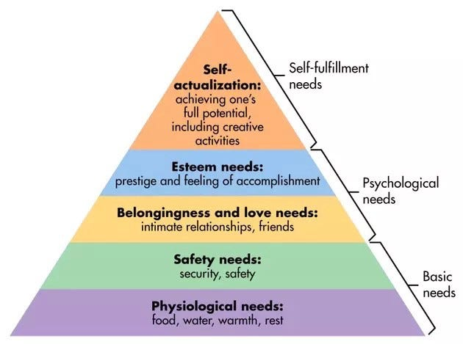
People Have Needs
Every person has needs that they consciously or subconsciously work to have met. When their needs are not met, people will resort to a variety of tactics to get what they need.

Slide 19
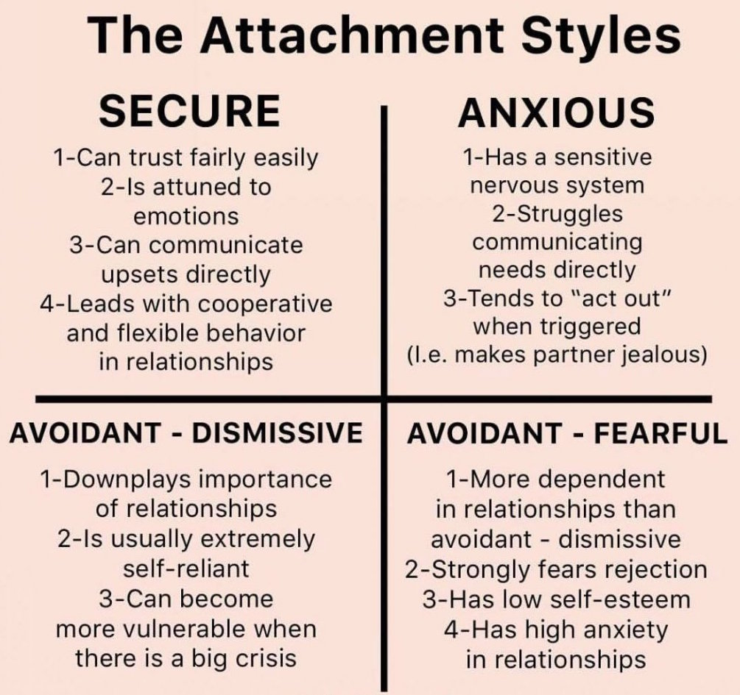
Attachment Styles
Everyone has an attachment style. Knowing both yours and others’ style is vitally important to boundaries!

Slide 20


Slide 21

Boundary Setting
Step Four:
Setting Your Boundaries

Slide 22
Three Steps to Boundaries
Say No!
Carrying Rocks
No Mission Creep
Saying No is okay!
You don’t need to explain yourself!
Don’t own others’ emotions when you say No!
Whose rocks are you carrying?
Whose rocks should you be carrying?
Empty your backpack!
Stay focused on what God has you doing.
Don’t allow the good to interrupt the great
Helping is good; enabling is bad.

Slide 23

Self-Care Concepts
Rest – Renewal - Rejuvenate

Slide 24


Slide 25

prayer
scripture
study

Slide 26
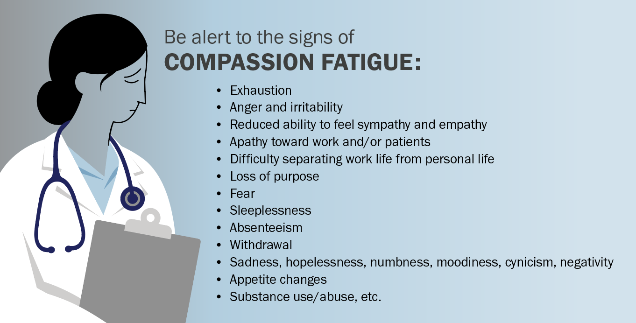

Slide 27

Self-Care Key Points
Engage in Energy Givers
Avoid Energy Takers
Be Intentional
No Interruptions
SLEEP
Exercise
Spiritual Disciplines

Slide 28
Key Points
Jesus had boundaries so you can as well!
Be Like Jesus
Stay focused on your call and don’t get distracted.
Don’t Overextend
Compassion Fatigue is real! Know the signs before it happens.
Recognize Burnout
Even Jesus needed rest and renewal. Again, be like Jesus!
Value Self-Care
Be as wise as a serpent and gentle as a dove – spiritual warfare is part of the job!
Serpent and Dove

Slide 29

Thank You!
Rev. Tom Mann, MA, BCMHC
heavydeepreal@gmail.com
www.heavydeepreal.com
www.tommann.org

